Slide 1
Network Layer:Routing

Slide 2








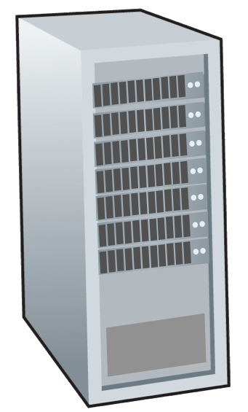







Routing protocols
mobile network
Routing protocol goal: determine “good” paths (equivalently, routes), from sending hosts to receiving host, through network of routers
path: sequence of routers packets traverse from given initial source host to final destination host
“good”: least “cost”, “fastest”, “least congested”
routing: a “top-10” networking challenge!
national or global ISP
application
transport
network
link
physical
network
link
physical
network
link
physical
network
link
physical
network
link
physical
network
link
physical
datacenter
network
application
transport
network
link
physical
enterprise
network

Slide 3
11.2 INTRA- AND INTERDOMAIN ROUTING
Today, an internet can be so large that one routing protocol cannot handle the task of updating the routing tables of all routers.
For this reason, an internet is divided into autonomous systems.
An autonomous system (AS) is a group of networks and routers under the authority of a single administration.
Routing inside an autonomous system is called intra-domain routing.
Routing between autonomous systems is called inter-domain routing

Slide 4
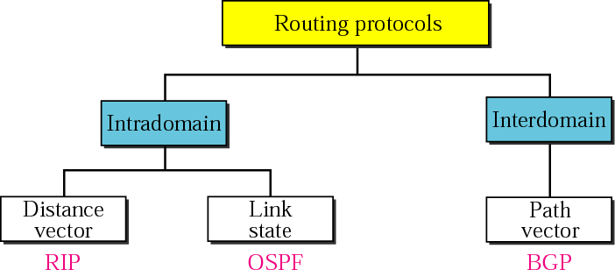
Popular routing protocols

Slide 5
Routing algorithm classification
global: all routers have complete topology, link cost info
“link state” algorithms
dynamic: routes change more quickly
periodic updates or in response to link cost changes
How fast do routes change?
static: routes change slowly over time
decentralized: iterative process of computation, exchange of info with neighbors
routers initially only know link costs to attached neighbors
“distance vector” algorithms
global or decentralized information?

Slide 6
Graph abstraction: link costs
5
c_{a,b}: cost of direct link connecting a and b
e.g., c_{w,z} = 5, c_{u,z} = ∞
cost defined by network operator: could always be 1, or inversely related to bandwidth, or inversely related to congestion
v
3
w
2
5
u
2
1
z
3
1
2
x
y
1
graph: G = (N,E)
N: set of routers = { u, v, w, x, y, z }
E: set of links ={ (u,v), (u,x), (v,x), (v,w), (x,w), (x,y), (w,y), (w,z), (y,z) }

Slide 7
Dijkstra’s link-state routing algorithm
centralized: network topology, link costs known to all nodes
accomplished via “link state broadcast”
all nodes have same info
computes least cost paths from one node (“source”) to all other nodes
gives forwarding table for that node
iterative: after k iterations, know least cost path to k destinations
notation
c_{x,y}: direct link cost from node x to y; = ∞ if not direct neighbors
D(v): current estimate of cost of least-cost-path from source to destination v
N': set of nodes whose least-cost-path definitively known

Slide 8
Dijkstra’s link-state routing algorithm
1 Initialization:
2 N' = {u} /* compute least cost path from u to all other nodes */
3 for all nodes v
4 if v adjacent to u /* u initially knows direct-path-cost only to direct neighbors */
5 then D(v) = c_{u,v} /* but may not be minimum cost! */
6 else D(v) = ∞
7
8 Loop
9
10
11
12
13
14
15 until all nodes in N'
find w not in N' such that D(w) is a minimum
add w to N'
update D(v) for all v adjacent to w and not in N' :
D(v) = min ( D(v), D(w) + c_{w,v} )
/* new least-path-cost to v is either old least-cost-path to v or known
least-cost-path to w plus direct-cost from w to v */

Slide 9
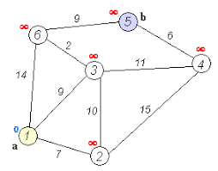
Dijkstra’s algorithm: an example
5
v
3
w
2
5
u
2
1
z
3
1
2
x
y
D(w),p(w)
5,u
4,x
3,y
3,y
1
Initialization (step 0): For all a: if a adjacent to then D(a) = c_{u,a}
find a not in N' such that D(a) is a minimum
add a to N'
update D(b) for all b adjacent to a and not in N' :
D(b) = min ( D(b), D(a) + c_{a,b} )

Slide 10
Dijkstra’s algorithm: an example
5
v
3
w
2
5
u
2
1
z
3
1
2
D(w),p(w)
5,u
4,x
3,y
3,y
x
y
1
resulting least-cost-path tree from u:
resulting forwarding table in u:
v
w
destination
outgoing link
v
x
y
w
x
(u,v)
(u,x)
(u,x)
(u,x)
(u,x)
route from u to v directly
u
z
x
route from u to all other destinations via x
y

Slide 11
Dijkstra’s algorithm: another example
x
9
5
7
4
8
u
3
w
y
z
2
3
7
4
v

Slide 12
Dijkstra’s algorithm: discussion
algorithm complexity: n nodes
each of n iteration: need to check all nodes, w, not in N
n(n+1)/2 comparisons: O(n²) complexity
message complexity:
each router must broadcast its link state information to other n routers
each router’s message crosses O(n) links: overall message complexity: O(n²)

Slide 13
Dijkstra’s algorithm: oscillations possible
when link costs depend on traffic volume, route oscillations possible
sample scenario:
routing to destination a, traffic entering at b, c, d with rates 1, e (<1), 1
link costs are directional, and volume-dependent
a
a
a
a
1
1+e
2+e
0
0
2+e
2+e
0
d
b
d
1
b
d
b
d
b
0
0
1+e
0
0
1+e
1
1
0
e
1
0
c
0
1
1
1
c
1+e
1
1
0
0
1
c
1
c
e
e
e
e
given these costs,
find new routing….
resulting in new costs
given these costs,
find new routing….
resulting in new costs
given these costs,
find new routing….
resulting in new costs
initially

Slide 14
Distance vector algorithm
Based on Bellman-Ford (BF) equation:
Bellman-Ford equation
Let D_{x}(y): cost of least-cost path from x to y.
Then:
D_{x}(y) = min_{v} { c_{x,v} + D_{v}(y) }
v’s estimated least-cost-path cost to y
min taken over all neighbors v of x
direct cost of link from x to v

Slide 15
Bellman-Ford Example
Suppose that u’s neighboring nodes, x,v,w, know that for destination z:
D_{v}(z) = 5
D_{w}(z) = 3
Bellman-Ford equation says:
5
D_{u}(z) = min { c_{u,v} + D_{v}(z),
c_{u,x} + D_{x}(z),
c_{u,w} + D_{w}(z) }
v
3
w
2
5
u
2
1
z
3
= min {2 + 5,
1 + 3,
5 + 3} = 4
1
2
x
y
1
D_{x}(z) = 3
node achieving minimum (x) is next hop on estimated least-cost path to destination (z)

Slide 16
Distance vector algorithm
key idea:
from time-to-time, each node sends its own distance vector estimate to neighbors
when x receives new DV estimate from any neighbor, it updates its own DV using B-F equation:
D_{x}(y) ← min_{v}{c_{x,v} + D_{v}(y)} for each node y ∊ N

Slide 17
Distance vector algorithm:
each node:
iterative, asynchronous: each local iteration caused by:
local link cost change
DV update message from neighbor
wait for (change in local link cost or msg from neighbor)
recompute DV estimates using DV received from neighbor
distributed, self-stopping: each node notifies neighbors only when its DV changes
neighbors then notify their neighbors – only if necessary
no notification received, no actions taken!
if DV to any destination has changed, notify neighbors

Slide 18
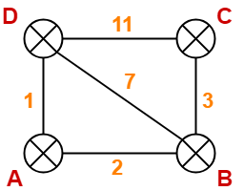
y
2
1
x
z
7

Slide 19
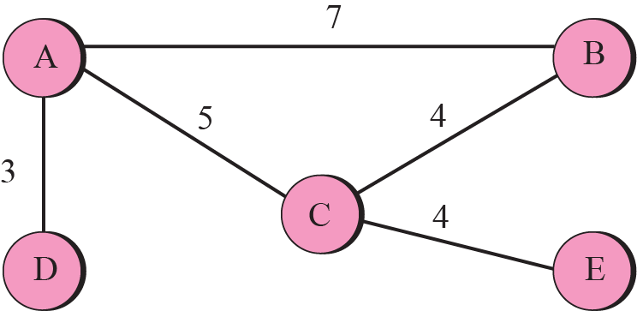
A graph for Bellman-Ford algorithm

Slide 20
When to Share Routing Table
Periodic Update
A node sends its routing table, normally 30 seconds, in a periodic update
Triggered Update
A node sends its routing table to its neighbors any time when there is a change in its routing table
1. After updating its routing table, or
2. Detects some failure in the neighboring links

Slide 21
Note:
In distance vector routing, each node shares its routing table with its immediate neighbors periodically and when there is a change.

Slide 22
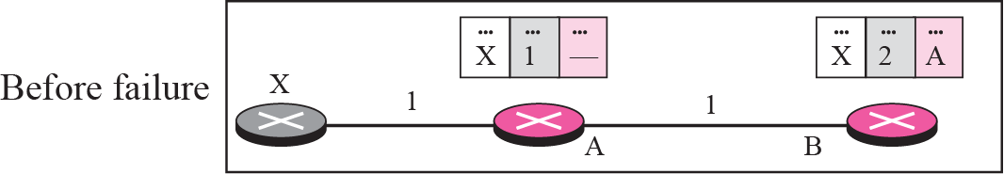
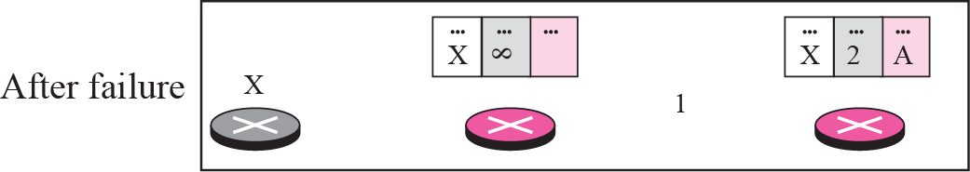
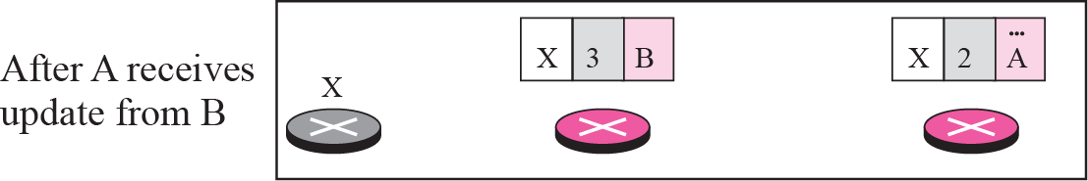
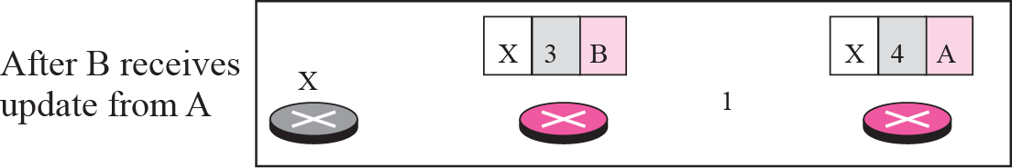
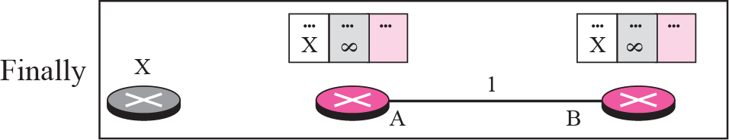
Figure Two-node instability

Slide 23
Distance vector: link cost changes
link cost changes:
node detects local link cost change
“bad news travels slow” – count-to-infinity problem:
60
y
4
1
x
z
50
y sees direct link to x has new cost 60, but z has said it has a path at cost of 5. So y computes “my new cost to x will be 6, via z); notifies z of new cost of 6 to x.
z learns that path to x via y has new cost 6, so z computes “my new cost to x will be 7 via y), notifies y of new cost of 7 to x.
y learns that path to x via z has new cost 7, so y computes “my new cost to x will be 8 via y), notifies z of new cost of 8 to x.
z learns that path to x via y has new cost 8, so z computes “my new cost to x will be 9 via y), notifies y of new cost of 9 to x.
…
see text for solutions. Distributed algorithms are tricky!

